Slide 1
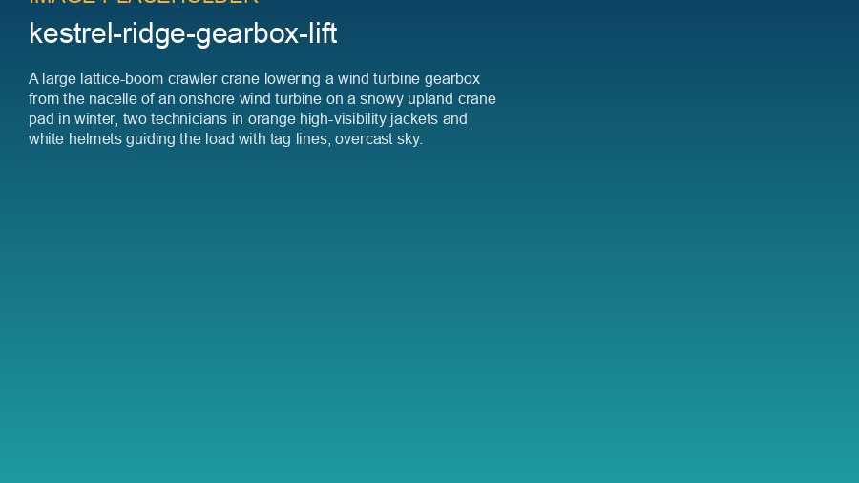
WEYLAND ENERGY
Lifting operations
Toolbox talk for the T-07 gearbox exchange, Kestrel Ridge

Slide 2
The lift
• 750 t crawler crane, gearbox approx. 38 t
• Lift height 95 m
• Wind limits: 10 m/s mean, 12 m/s gusts at hook height
WEYLAND ENERGY · Toolbox Talk – Lifting Operations
2

Slide 3
Roles
Role | Name
Lift supervisor | Borders Heavy Lift
Appointed person | Borders Heavy Lift
Nacelle team lead | Stuart Laidlaw (Highline)
Site manager | Ben Okoye
HSE | Hannah Weber
WEYLAND ENERGY · Toolbox Talk – Lifting Operations
3

Slide 4
Never
• Stand under a suspended load
• Guide a load by hand – use tag lines
• Start a lift without a briefing
• Continue when the wind limit is reached
WEYLAND ENERGY · Toolbox Talk – Lifting Operations
4

Slide 5
Winter specials
• Check outrigger mats every morning
• Ice on the crane boom – no lifting
• Warm-up breaks every 2 hours
WEYLAND ENERGY · Toolbox Talk – Lifting Operations
5

Slide 6
WEYLAND ENERGY
Questions?
Everyone has the right to stop the job

